Slide 1
Technology for Success: Computer Concepts

Slide 2
Module 4
Operating Systems and File Management

Slide 3
Lesson Objectives
Explain the pros and cons of different types of operating systems
Explain how an operating system works
Personalize a computer operating system, as well as its software and hardware, to increase productivity
Manages files and folders

Slide 4
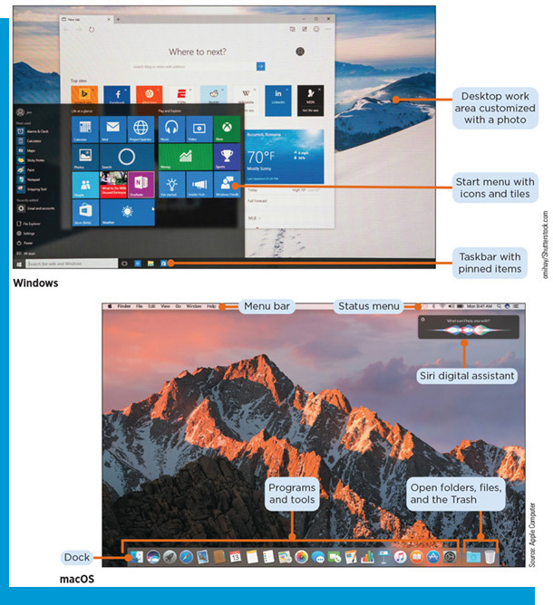
The Pros and Cons of Different Types of Operating Systems
Explain the differences between an operating system and system software
Explain the differences between the major operating systems
Identify the desktop components

Slide 5
Differences Between Operating Systems and System Software
System software: The software that runs a computer, including the operating system and the utilities
Operating system (O S): a program that manages the complete operation of your computer or mobile device and lets you interact with it.
Platform
Most operating systems come installed on your computer or device

Slide 6
Differences Between the Major Operating Systems (1 of 5)
Standard Operating System Functions
Starting and shutting down a computer or device
Managing programs
Managing memory
Coordinating tasks
Configuring devices
Establishing an Internet connection
Monitoring performance
Providing file management
Updating operating system software
Monitoring security
Controlling network access

Slide 7
Differences Between the Major Operating Systems (2 of 5)
Operating Systems Features
Graphical user interface (G U I)
Utilities
Software as a Service (SaaS)
Open/closed source

Slide 8
Differences Between the Major Operating Systems (3 of 5)
Desktop Operating Systems
Table 4-2: Desktop operating systems
OS | Available for | Notable features
Windows | Desktop computers, laptops, and some tablets | Supports the Cortana virtual assistant, touchscreen input, HoloLens headsets, and built-in apps such as the Microsoft Edge browser
macOS | Macintosh desktop computers and laptops | Includes the Siri virtual assistant, coordination with Apple mobile devices, and cloud file storage
UNIX | Most computers and devices | Multitasking operating system with many versions, as the code is licensed to different developers
LINUX | Desktop computers, laptops, and some tablets | Distributed under the terms of a General Public License (G P L), which allows you to copy the OS for your own use, to give to others, or to sell
Chrome OS | Chromebook laptops | Based on Linux, uses the Google Chrome browser as its user interface, and primarily runs web apps (an app stored on an Internet server that can be run entirely in a web browser)

Slide 9
Differences Between the Major Operating Systems (4 of 5)
Server Operating Systems
Table 4-3: Server operating systems
OS | Notable features
Windows Server | The server version of Windows. It includes advanced security tools and a set of programs called Internet Information Services that manage web apps and services.
macOS Server | Supports all sizes of networks and servers. One unique feature is that it lets authorized users access servers their iPhones or other Apple devices.
UNIX | A multipurpose operating system that can run on a desktop PC or a server. Many web servers, which are Internet computers that store webpages and deliver them to your computer or device, use UNIX because it is a powerful, flexible operating system.

Slide 10
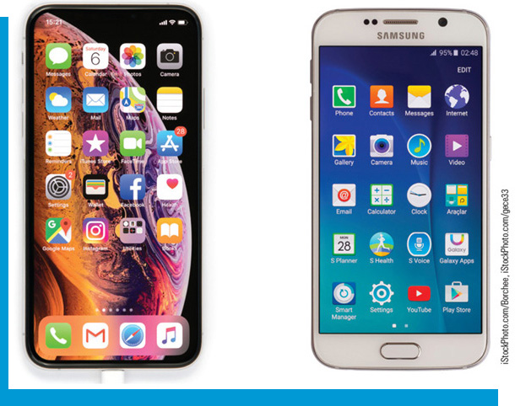
Differences Between the Major Operating Systems (5 of 5)
Mobile Operating Systems
Table 4-4: Mobile operating systems
OS | Notable features
Android | Developed by Google based on LINUX, and designed to be run on many types of smartphones and tablets
iOS | Runs only on Apple devices, including the iPhone, iPad, and iPod; derived from macOS

Slide 11
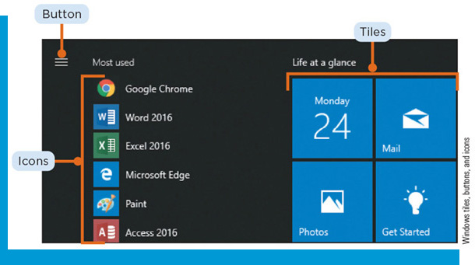
Identify Desktop Components
Desktop
Window
Menu
Dialog boxes
File
Data file
Executable file
File format
File extension
Folder
Library

Slide 12
Explain How an Operating System Works
Describe the purpose of an operating system
Describe how an operating system manages memory
Outline the steps necessary for the boot process
Explain how operating systems manage input and output

Slide 13
The Purpose of an Operating System
Responsible for coordinating the resources and activities on a computer
Manages interactions between hardware and software

Slide 14
Describe How an Operating System Manages Memory
Memory
Volatile memory
Nonvolatile memory
RAM (random access memory)
Cache
Virtual memory
ROM (read-only memory)
Flash memory

Slide 15
Steps in the Boot Process
Boot Process
The computer receives power from the power supply or battery and sends it to the circuitry
The processor runs the bootstrap program
The bootstrap program executes a series of tests to check the components
The computer loads the operating system files into RAM, including the kernel
The computer loads the system configuration information and loads startup programs

Slide 16
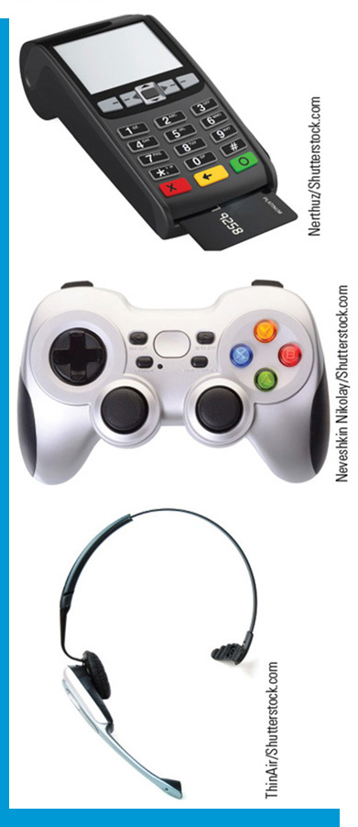
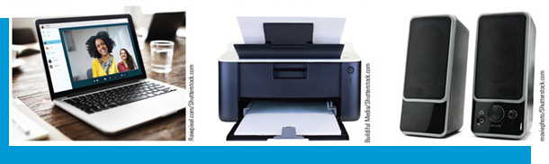
How Operating Systems Manage Input and Output
Input and Output
Input: any data and instructions entered into the memory of a device
Output: information processed into a useful form
Output is the goal of input
Buffer/Spooling

Slide 17
Personalize an OS to Increase Productivity
Customize system software
Customize hardware using system software
Manage desktop windows
Use administrative tools

Slide 18
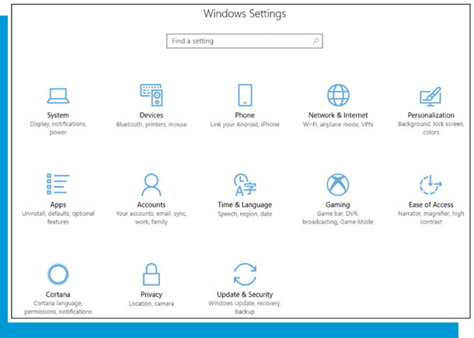
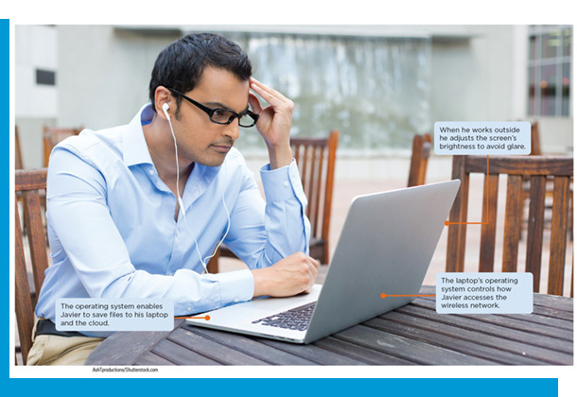
Customize System Software (1 of 2)
Customize Settings—change default settings
Change screen brightness
Add desktop themes
Adjust screen resolution
Adding a sound scheme
Pinning frequently used apps to the taskbar
Selecting items to appear in the Notification area

Slide 19
Customize System Software (2 of 2)
Link your smartphone to your computer
Uninstall apps
Add accounts
Manage network connections
Adjust privacy settings
Customize desktop
Move taskbar
Add shortcuts

Slide 20
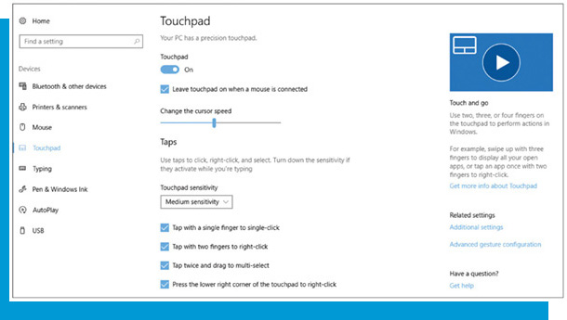
Customize Hardware Using System Software
Customize Hardware
Pointing device
Switch mouse buttons
Adjust trackpad sensitivity
Keyboard
Change commands associated with certain keys/keyboard shortcuts
Change language/dialect
Adjust settings for toggle keys

Slide 21
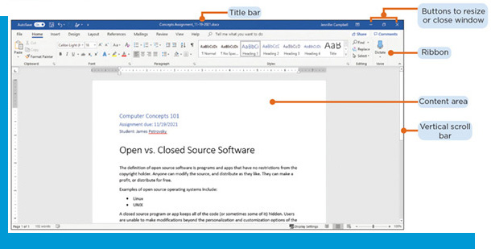
Manage Desktop Windows (1 of 2)
Common Elements of Windows
Center area displays contents
Title bar at the top displays the name of the app, file, or folder shown in the window
Buttons
Maximize
Minimize
Close
Restore Down
Vertical and horizontal scroll bars

Slide 22
Manage Desktop Windows (2 of 2)
Multiple windows can be open at once and appear side-by-side or stacked
The active window is the one currently being used
Windows can be resized and dragged to new locations
Program window
Folder window

Slide 23
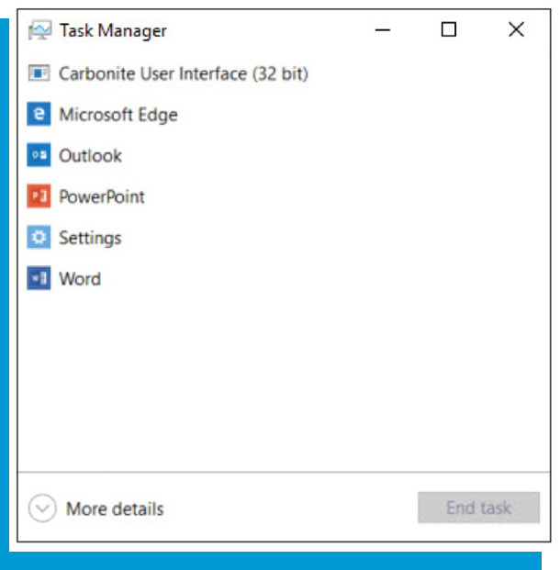
Use Administrative Tools (1 of 6)
Resources
Components required to perform work (processor, RAM, storage space, and connected devices)
Windows Task Manager
Interact with a G U I
Tile
Icon
Button

Slide 24
Use Administrative Tools (2 of 6)
Adjust Power Settings
Shutdown/sleep options
Battery usage

Slide 25
Use Administrative Tools (3 of 6)
Utilities
Disk cleanup utility
Recycle bin/trash
File utilities
File management
Search tool
File compression

Slide 26
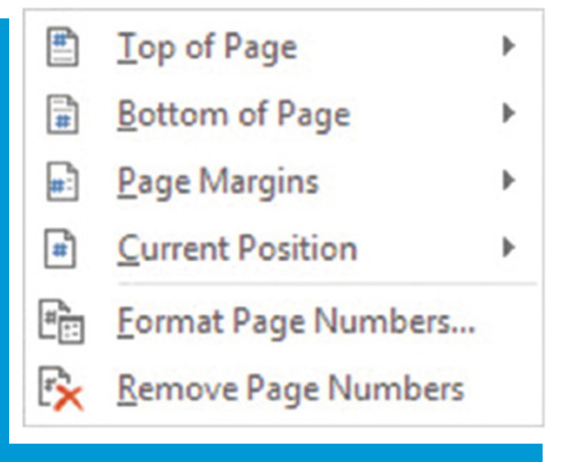
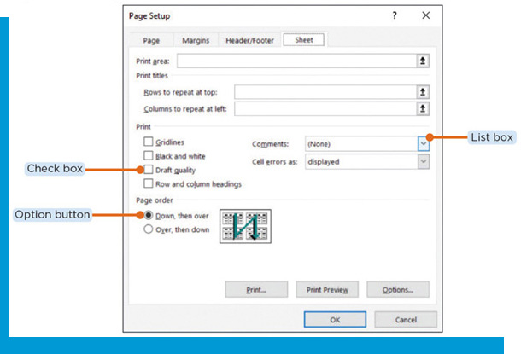
Use Administrative Tools (4 of 6)
Customize Windows Operating System
Settings app
Control panel
Menus
Shortcut menu
Dialog box
Option/radio buttons
Check boxes
List boxes

Slide 27
Use Administrative Tools (5 of 6)
Run More than One Operating System
Virtual machine
Requires an app that is specifically designed to set up and manage virtual machines
Installation files for the operating system to run on the virtual machine are also required
Runs on a partition

Slide 28
Use Administrative Tools (6 of 6)
Manage User Accounts
User accounts identify the resources a user can access when working with the computer
Protect your computer against unauthorized access
Administrator account provides full access

Slide 29
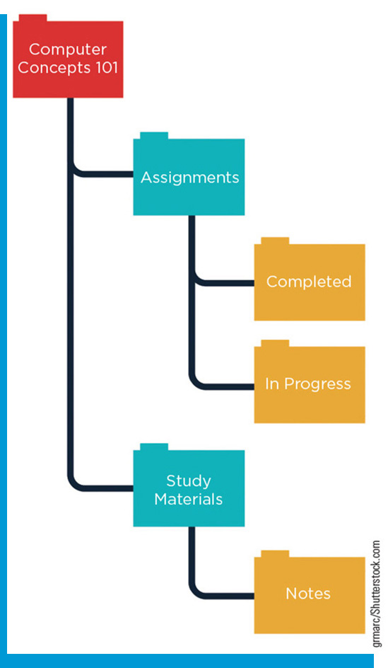
Manage Files and Folders
Compress and uncompress files
Save files to folders and filing systems
Determine file properties
Manage file names and file placement
Manage folder names and folder placement
Organize files using file management tools

Slide 30
Compress and Uncompress Files
File size is usually measured in kilobytes (KB) (thousands of bytes of data), megabytes (MB) (millions of bytes of data), or gigabytes (GB) (billions of bytes of data)
Files and folders may need to be compressed before they can be shared or transferred

Slide 31
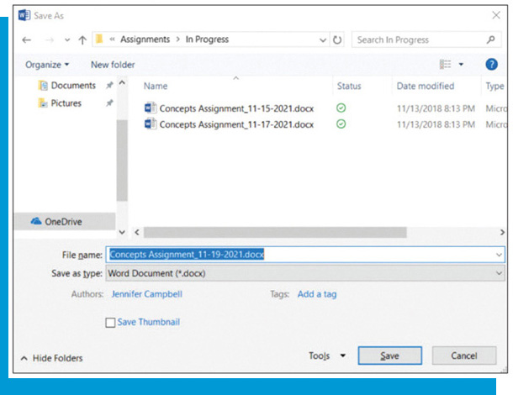
Save Files to Folders and Filing Systems
Name the file
Save to the computer, flash drive, or cloud
If creating or editing a file, it should be saved frequently
Files you work on using a web app save changes as you make them
Use the Save As or Save a Copy dialog box to save a file with a new name or in a new location

Slide 32
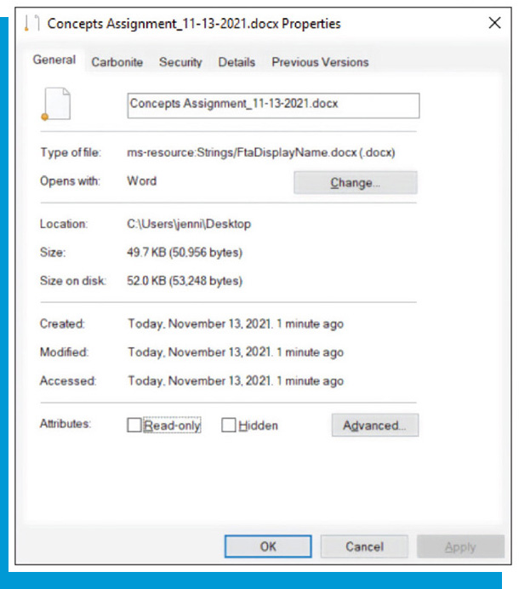
Determine File Properties
Every file has properties, such as name, type, location, and size
Dates: when the file was created, modified, last accessed
The operating system assigns some properties to files, such as type or format, and updates other properties, such as date, size, and location

Slide 33
Manage File Names and File Placement (1 of 2)
File Names
When you save a file, you must give it a name that follows your operating system’s rules for file-naming conventions
Most file names contain an extension that tells about its contents, such as the type of platform or app on which the file can be used
File name extensions are added automatically when you save a file, but you can change the extension in some cases

Slide 34
Manage File Names and File Placement (2 of 2)
File Placement
Each folder can only include one file with the same name of the same type
Be as specific as possible when naming files
Copying or moving files: use the Clipboard or drag between file management windows
To open a saved file, navigate to the file’s location using the file manager or the Open dialog box from within a program or app. Double-click it or select it and click the Open button.

Slide 35
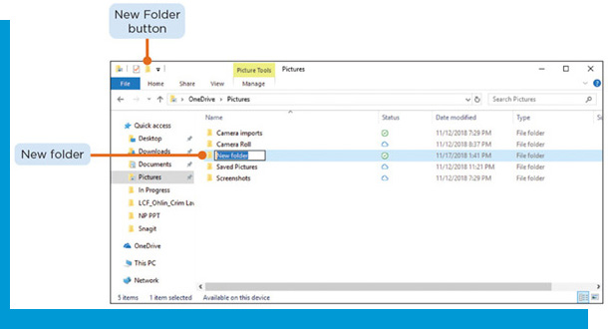
Manage Folder Names and Folder Placement
You can create a new folder in a file manager such as File Explorer or Finder
To create a folder, click the New folder button in your file manager. The folder name by default is “New folder.” To rename the folder something meaningful, select the folder and click it again to make it editable, then type the name and enter.
Within file manager, you can move, copy, and delete folders the same as a file

Slide 36
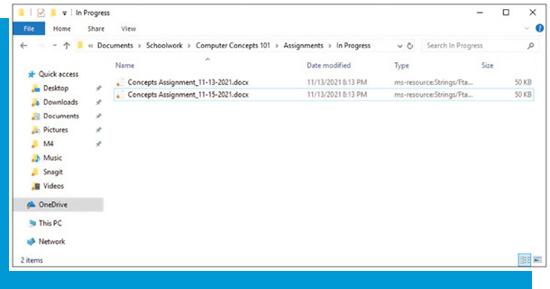
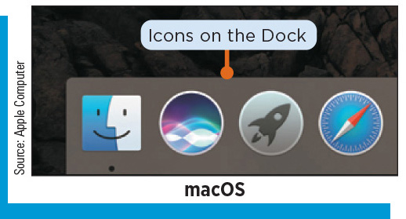
Organize Files Using File Management Tools
File Management
Windows 10: File Explorer
macOS: the Finder
File manager functions
View frequently or recently opened files and folders
View the main folders on your computer or device
Search by file name, content, date, and more

